Slide 1
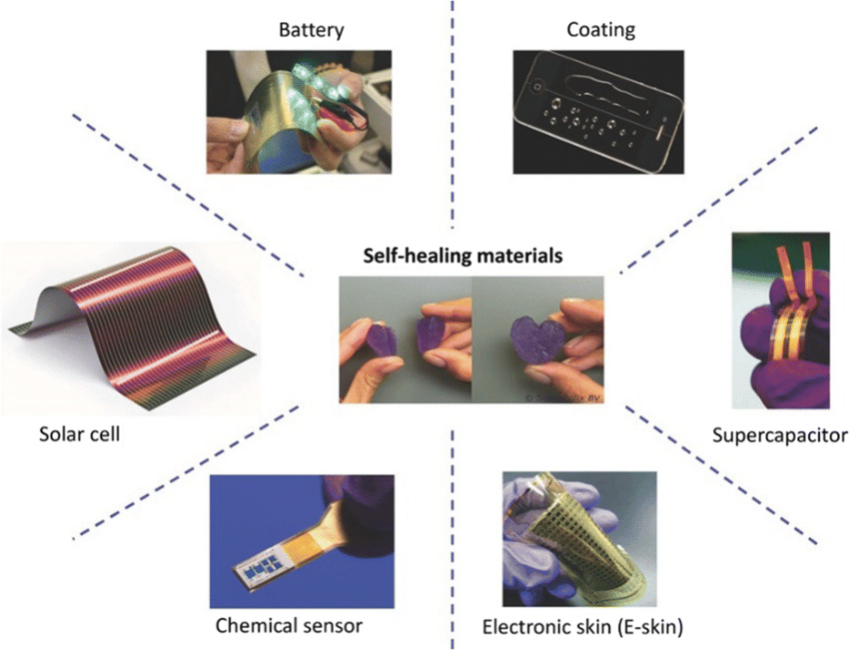
Welcome to the world of self-healing materials. These revolutionary substances are transforming industries by autonomously repairing damage. Discover how they're shaping a more sustainable and efficient future.
Self-Healing Materials

Slide 2
Self-Healing Materials
Welcome to the world of self-healing materials. These revolutionary substances are transforming industries by autonomously repairing damage. Discover how they're shaping a more sustainable and efficient future.

Slide 3
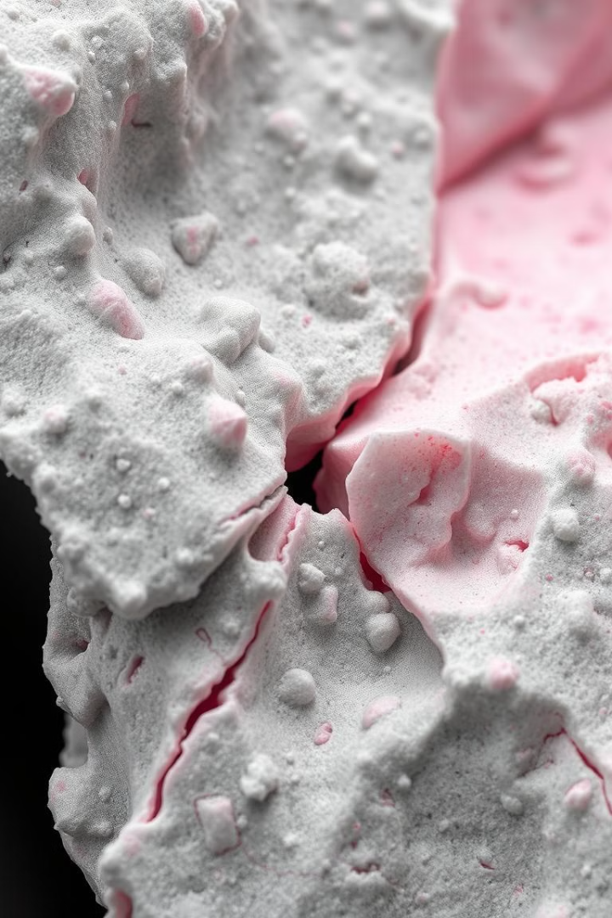
Understanding Self-Healing Materials
4. Non-Autonomic Self-Healing: Materials that require an external trigger, such as heat, light, or mechanical stress, to initiate the healing process.
Definition
3. Autonomic Self-Healing: Materials that can initiate the healing process without external stimuli, relying on intrinsic mechanisms such as chemical reactions or physical processes.
2. Extrinsic Self-Healing: Materials containing a secondary phase or agent that provides the self-healing capability. This agent can be a liquid, gel, or solid that flows into the damaged area to repair cracks or defects.
Intrinsic Self-Healing: Materials with inherent self-healing capabilities, where the repair process is triggered by micro-damage or stress. Examples include polymers with cross-linked networks, which can reform broken bonds to restore material integrity.
1
Self-healing materials repair damage without external intervention, mimicking biological systems.
2
Purpose
They enhance durability, reduce maintenance costs, and improve sustainability across various applications.
3
Key Sectors
Automotive, construction, electronics, aerospace, and biomedical industries benefit from these innovative materials.

Slide 4


Self-Healing Material Background
Self-healing materials are artificial or synthetically created substances that possess the ability to automatically repair damages to themselves without external diagnosis or human intervention. The theoretical background of self-healing materials encompasses various mechanisms and approaches, including:
The concept of self-healing materials was first proposed in the early 2000s by Dr. Scott White and his research team at the University of Illinois at Urbana-Champaign. Their pioneering work, published in 2001, introduced a microcapsule-based self-healing polymer that could repair cracks autonomously
Intrinsic Self-Healing: Materials with inherent self-healing capabilities, where the repair process is triggered by micro-damage or stress. Examples include polymers with cross-linked networks, which can reform broken bonds to restore material integrity.
2. Extrinsic Self-Healing: Materials containing a secondary phase or agent that provides the self-healing capability. This agent can be a liquid, gel, or solid that flows into the damaged area to repair cracks or defects.
3. Autonomic Self-Healing: Materials that can initiate the healing process without external stimuli, relying on intrinsic mechanisms such as chemical reactions or physical processes.
4. Non-Autonomic Self-Healing: Materials that require an external trigger, such as heat, light, or mechanical stress, to initiate the healing process.
Self-healing materials draw inspiration from nature, where biological systems repair damaged tissues through complex processes. These principles support the analysis of various approaches, including nano-beam healing elements, passive self-healing, autonomic self-healing, and ballistic self-repair.

Slide 5
Self-Healing Material Background
Origins And Principles
Self-healing materials are artificial or synthetically created substances that possess the ability to automatically repair damages to themselves without external diagnosis or human intervention. The theoretical background of self-healing materials encompasses various mechanisms and approaches, including:
The concept of self-healing materials was first proposed in the early 2000s by Dr. Scott White and his research team at the University of Illinois at Urbana-Champaign. Their pioneering work, published in 2001, introduced a microcapsule-based self-healing polymer that could repair cracks autonomously
Self-healing materials draw inspiration from nature, where biological systems repair damaged tissues through complex processes. These principles support the analysis of various approaches, including nano-beam healing elements, passive self-healing, autonomic self-healing, and ballistic self-repair.
Intrinsic Self-Healing: Materials with inherent self-healing capabilities, where the repair process is triggered by micro-damage or stress. Examples include polymers with cross-linked networks, which can reform broken bonds to restore material integrity.
2. Extrinsic Self-Healing: Materials containing a secondary phase or agent that provides the self-healing capability. This agent can be a liquid, gel, or solid that flows into the damaged area to repair cracks or defects.
3. Autonomic Self-Healing: Materials that can initiate the healing process without external stimuli, relying on intrinsic mechanisms such as chemical reactions or physical processes.
4. Non-Autonomic Self-Healing: Materials that require an external trigger, such as heat, light, or mechanical stress, to initiate the healing process.

Slide 6
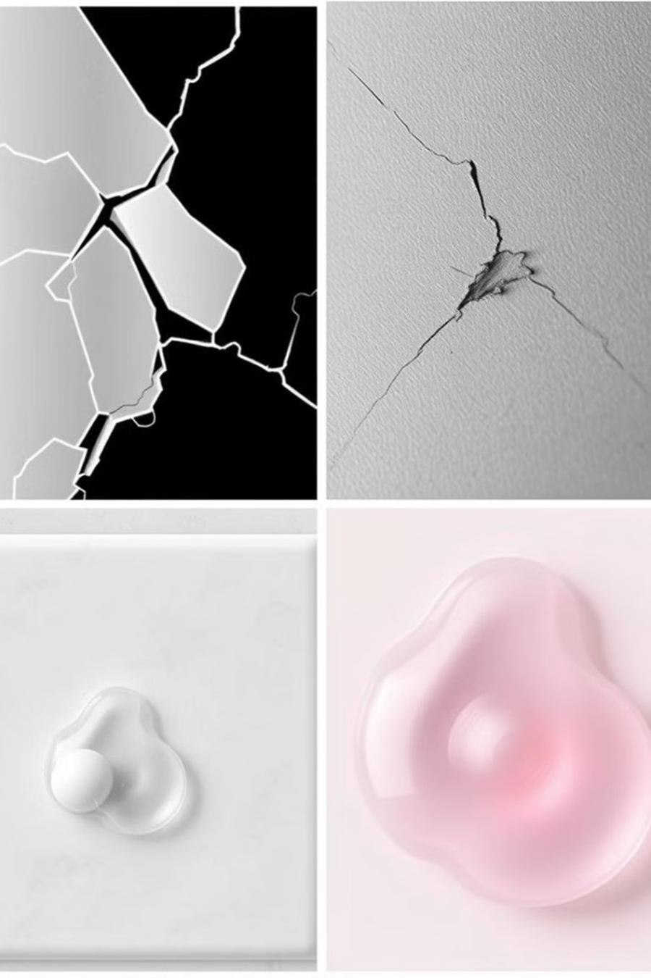
Origins And Principles
Mechanism of Various Self-Healing Materials
Materials Used in Self-Healing Technology
1
Microcapsules :
Contains a healing agent, such as a polymer or a liquid, which is released when the material is damaged. The healing agent flows to the damaged area, filling the gap and restoring the material’s properties. (e.g., polyurethane foam coating)
The concept of self-healing materials was first proposed in the early 2000s by Dr. Scott White and his research team at the University of Illinois at Urbana-Champaign. Their pioneering work, published in 2001, introduced a microcapsule-based self-healing polymer that could repair cracks autonomously
Material
Applications
Key Properties
2
Vascular Networks :
Polymers
Coatings, automotive parts, electronics
Flexible, versatile
Comprise a network of microchannels or tubes that contain a healing agent. When damage occurs, the healing agent flows through the network to the affected area, promoting repair, and mimicking blood vessels in organisms.
Self-healing materials draw inspiration from nature, where biological systems repair damaged tissues through complex processes. These principles support the analysis of various approaches, including nano-beam healing elements, passive self-healing, autonomic self-healing, and ballistic self-repair.
3
Reversible Cross-Linking :
Metals
Infrastructure, aerospace
Strong, conductive
Materials with reversible cross-links can reform and reorganize their molecular structure in response to damage, restoring their original properties.
Ceramics/Composites
Aerospace, construction
Heat-resistant, durable
4
Biological Mimicry :
Epicuticular Wax: Inspired by the self-cleaning properties of plant leaves, epicuticular wax can be used to create self-healing coatings that replenish and reform in response to damage.
Hydrogels
Biomedical applications
Water-compatible, biocompatible

Slide 7
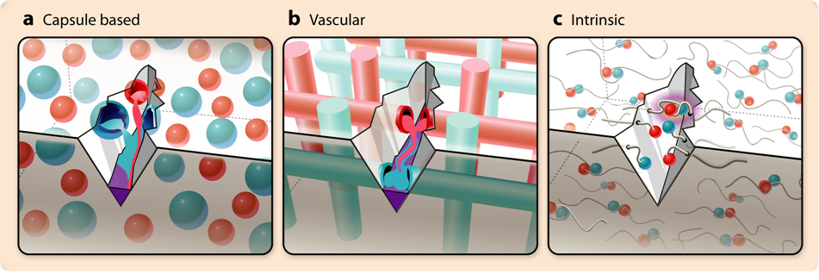
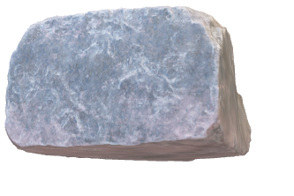
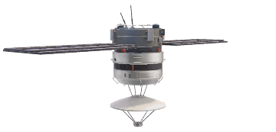
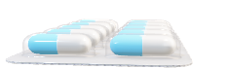

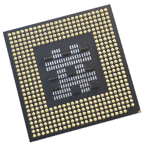
Mechanism of Various Self-Healing Materials
Key Mechanisms Behind Self-healing
Microencapsulation:
Microencapsulation involves enclosing active substances (like drugs or nutrients) within a polymeric shell to protect them from environmental factors and control their release.
Vascular networks:
Vascular networks refer to engineered systems that mimic blood vessel structures, facilitating nutrient and waste transport in tissues.
Vascular networks:
Polymers with reversible bonds (e.g., hydrogen or ionic bonds) can break and reform, allowing them to “self-repair” under specific conditions like heat.
Bacterial Healing:
Bacterial healing is a process where certain bacteria are used to promote healing in materials, often in construction or biomedical applications.
1
Microcapsules :
Contains a healing agent, such as a polymer or a liquid, which is released when the material is damaged. The healing agent flows to the damaged area, filling the gap and restoring the material’s properties. (e.g., polyurethane foam coating)
2
Vascular Networks :
Comprise a network of microchannels or tubes that contain a healing agent. When damage occurs, the healing agent flows through the network to the affected area, promoting repair, and mimicking blood vessels in organisms.
3
Reversible Cross-Linking :
Materials with reversible cross-links can reform and reorganize their molecular structure in response to damage, restoring their original properties.
4
Biological Mimicry :
Epicuticular Wax: Inspired by the self-cleaning properties of plant leaves, epicuticular wax can be used to create self-healing coatings that replenish and reform in response to damage.

Slide 8

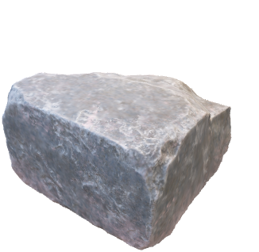
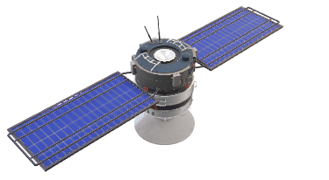
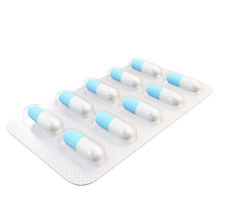

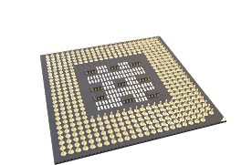
Applications Across Industries
Mechanism of Various Self-Healing Materials
Energy Storage: Integrating self-healing materials into energy storage technologies can enhance reliability and durability, paving the way for sustainable and resilient solutions.
Electronics: Self-healable organic electronic materials have been used in devices such as energy-harvesting devices, field-effect transistors, sensors, and electronic skin, demonstrating high performance and safety.
Automotive: Self-healing coating materials can repair surface damage resulting from road debris or parking incidents, reducing maintenance expenses and preserving resale value.
Aerospace: Self-healing materials can provide innovative solutions for enhancing durability and safety in aerospace applications.
Biomedicine: Self-healing materials hold immense potential for implantable devices and prostheses, enabling improved durability and reducing the risk of device failure.
Construction: Self-healing materials can be used to develop innovative solutions for building and infrastructure maintenance, reducing repair costs and improving overall performance.
Epicuticular Wax: Inspired by the self-cleaning properties of plant leaves, epicuticular wax can be used to create self-healing coatings that replenish and reform in response to damage.
Contains a healing agent, such as a polymer or a liquid, which is released when the material is damaged. The healing agent flows to the damaged area, filling the gap and restoring the material’s properties. (e.g., polyurethane foam coating)
Comprise a network of microchannels or tubes that contain a healing agent. When damage occurs, the healing agent flows through the network to the affected area, promoting repair, and mimicking blood vessels in organisms.
Materials with reversible cross-links can reform and reorganize their molecular structure in response to damage, restoring their original properties.
Vascular Networks :
Microcapsules :
4
Biological Mimicry :
3
2
1
Reversible Cross-Linking :

Slide 9
The Future of Self-Healing Materials
Applications Across Industries
Energy Storage: Integrating self-healing materials into energy storage technologies can enhance reliability and durability, paving the way for sustainable and resilient solutions.
Electronics: Self-healable organic electronic materials have been used in devices such as energy-harvesting devices, field-effect transistors, sensors, and electronic skin, demonstrating high performance and safety.
Automotive: Self-healing coating materials can repair surface damage resulting from road debris or parking incidents, reducing maintenance expenses and preserving resale value.
Aerospace: Self-healing materials can provide innovative solutions for enhancing durability and safety in aerospace applications.
Biomedicine: Self-healing materials hold immense potential for implantable devices and prostheses, enabling improved durability and reducing the risk of device failure.
Construction: Self-healing materials can be used to develop innovative solutions for building and infrastructure maintenance, reducing repair costs and improving overall performance.
1
Mass Production
Scaling up manufacturing processes will reduce costs, making self-healing materials more accessible.
2
Advanced Applications
Expansion into wearables, smart homes, and infrastructure will revolutionize daily life.
3
AI and IoT Integration
Real-time monitoring and repair activation will enhance efficiency and preemptive maintenance.
4
Sustainability Focus
Reducing waste and environmental impact across industries will contribute to a greener future.

Slide 10
Overcoming Challenges in Self-Healing Materials
Cost Barriers
Scalability Issues
Performance Optimization
High production costs limit widespread adoption. Researchers are exploring cost-effective synthesis methods.
Large-scale application remains challenging. New manufacturing processes are being developed for industrial use.
Enhancing durability of healing agents and ensuring complete strength restoration after healing are ongoing goals.
Scaling up manufacturing processes will reduce costs, making self-healing materials more accessible.
Expansion into wearables, smart homes, and infrastructure will revolutionize daily life.
Real-time monitoring and repair activation will enhance efficiency and preemptive maintenance.
Reducing waste and environmental impact across industries will contribute to a greener future.
Advanced Applications
Mass Production
AI and IoT Integration
4
Sustainability Focus
2
3
1

Slide 11
Acknowledgement
We would like to express our heartfelt appreciation to the visionary scientists, engineers, and research institutions that have contributed to the development of self-healing materials. The groundbreaking work of Dr. Scott White and his team at the University of Illinois at Urbana-Champaign, who introduced the concept of microcapsule-based self-healing polymers, has been instrumental in inspiring the field. Their pioneering research has opened new horizons in material science, influencing innovative approaches for autonomic and non-autonomic healing mechanisms.
We also acknowledge the contributions of multidisciplinary research teams worldwide who have expanded on these early concepts, exploring the potential of vascular networks, reversible cross-linking, and bio-inspired healing processes. Their efforts have led to significant advancements in the application of self-healing materials across industries, enhancing the resilience and sustainability of products ranging from consumer electronics and automotive coatings to aerospace components and biomedical devices.
Cost Barriers
High production costs limit widespread adoption. Researchers are exploring cost-effective synthesis methods.
Scalability Issues
Large-scale application remains challenging. New manufacturing processes are being developed for industrial use.
Performance Optimization
Enhancing durability of healing agents and ensuring complete strength restoration after healing are ongoing goals.

Slide 12
Conclusion
Self-healing materials represent a breakthrough in material science, offering innovative solutions for autonomous repair in various applications, from energy storage and automotive to biomedical and construction fields. These materials, inspired by natural healing mechanisms, promise enhanced durability, reduced maintenance costs, and a more sustainable future. Although challenges remain, such as high production costs and scalability, ongoing research is paving the way for their broader application.

